Slide 1


Smart Contracts with NEO
A Distributed Smart Economy Network
Ilin Kazandzhiev
Technical Writer
Academy School of Blockchain
http://kingsland.academy

Slide 2

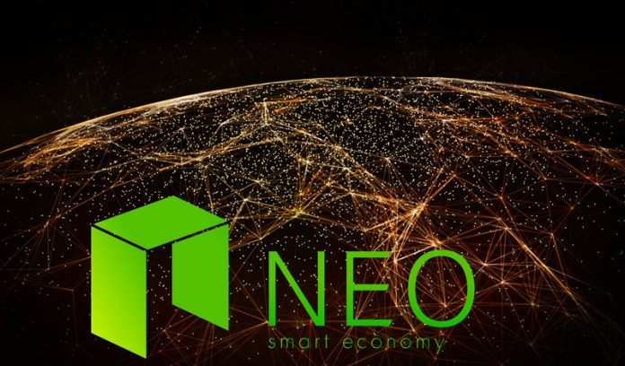


Table of Contents
NEO Background: Antshares
What is NEO and GAS
NEO Smart Contracts
Comparison between NEO and Ethereum

Slide 3

NEO Background: Antshares
Antshares Rebrands, NEO Smart Economy

Slide 4
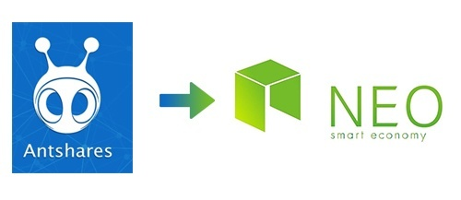
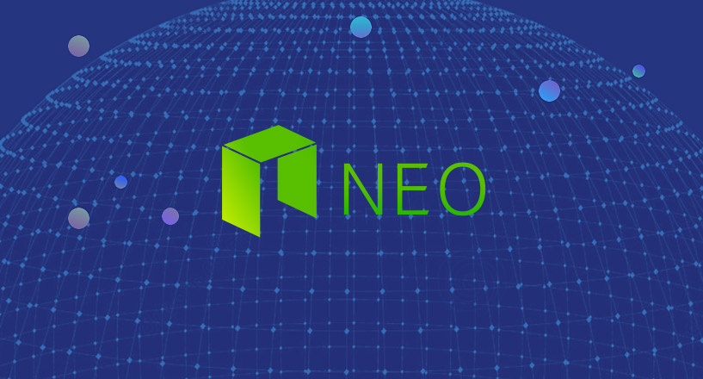
History of NEO (Antshares)
Neo began life as AntShares (ANS) in 2014, founded by Da Hongfei
Antshares == the first open-source blockchain platform developed in China
Mid 2017 Antshares announced a complete rebranding of its blockchain solution to NEO
NEO from Greek language means "newness, novelty and youth"

Slide 5
What is New in NEO?
NEO developers highlights the strengths of their new advanced smart contract code and DApps
It supports decentralized commerce, digital identities and the digitization of many different assets
This rebranding of Antshares to NEO represents a new direction for the development of China's blockchain

Slide 6
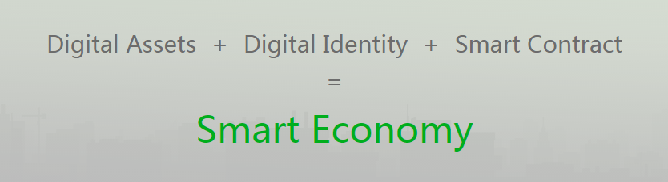
What is NEO Smart Economy?
Blockchain based economy and trade
Any physical asset can be represented as a Digital Asset in the NEO blockchain
NEO has the technology to support Digital Identity
Trade agreements are written in programming code using a Smart Contract

Slide 7



NEO Technical Features
The technology underlying NEO supports multiple types of digital assets
Digital certificates are supported, full legal protection for all digital assets on NEO platform
Buyers and sellers of digital assets will be handled peer-to-peer
Without need of third party

Slide 8



NEO Technical Features
Turing-complete smart contracts, with high certainty and finality, support unlimited scalability when run in NeoVM
NeoContract supports multiple programming languages such as C#, Java, and Python
Developers can rapidly develop smart contracts based on the NEO platform without learning a unique language
provides shorter startup times and efficient execution
Deterministic calling tree-technology allows NEO to achieve unlimited scalability

Slide 9



NEO Technical Features
Consensus nodes use Byzantine Fault Tolerance Algorithm
BFT reaches consensus and ensures the finality of transactions
Cross-Chain Assets Swap Protocol
Cryptography signing and encryption technique to avoid quantum crisis by Turing encryption and decryption

Slide 10

Coins: NEO and GAS
NEO Wallet, GAS Claim

Slide 11
NEO Platform Uses Two Separate Tokens
Two tokens behind the NEO platform: NEO and GAS
NEO is not a currency or asset
NEO stands as voting rights in NEO governance and management
Owning 1 NEO entitles you to a vote who will be the bookkeepers for the next block
NEO stakeholders vote on network changes
There are 100 million total NEO
NEO tokens cannot be subdivided

Slide 12
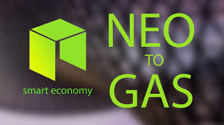
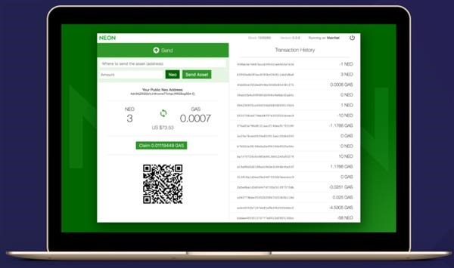
How to Get and Store GAS?
GAS is distributed with every new block
If you own NEO when a block is completed you’ll receive GAS
You receive GAS by staking NEO in the NEON wallet
NEON is an open source cross-platform light wallet for the NEO blockchain
Owning 1 NEO would earn you around .0003-.0005 GAS per day

Slide 13
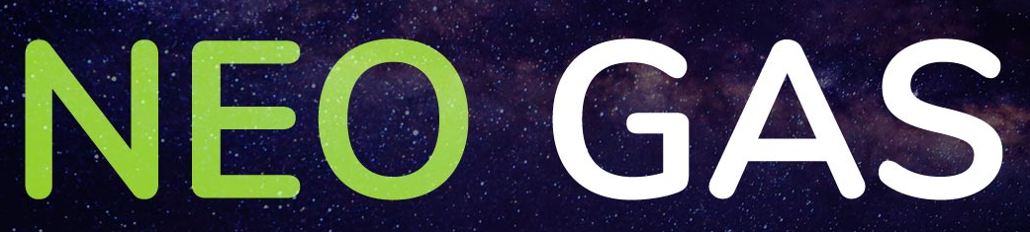
What is GAS Purpose?
GAS is the operational token that fuels the smart contracts built on the NEO blockchain
NEO uses a separate token like GAS so that ownership of NEO is not directly tied to the utilization of the platform
The supply of GAS grows by 8 with every block (15-25 seconds)
These 8 GAS are split between all NEO holders. The maximum limit of GAS is 100 million tokens

Slide 14
NEO Smart Contracts
C# and Java Code in the NeoVM

Slide 15

NEO Smart Contracts 2.0
Neo supports many programming languages:
Java and C#
Kotlin, Python
This is greatly lowering the difficulty for developers to write smart contracts
By making its programming languages more inclusive, NEO hopes to attract a larger community of developers
All contracts and advanced features on NEO are powered with GAS

Slide 16
Advanced Features Powered by GAS
NeoX
can achieve atomic assets swap and
guarantee the operation consistency of smart contracts executed on different chains
promises to offer interoperability between multiple blockchains
NeoFS
NEO is implementing a file storage and sharing on the blockchain
This would make it easy to transfer digital files as part of a contract
NeoQS
Neo will some day use a lattice-based mechanism (Quantum Safe)

Slide 17
NEO Smart Contract in C# – Example
using Neo.SmartContract.Framework;
using Neo.SmartContract.Framework.Services.Neo;
namespace Neo.SmartContract
{
public class TestContract: SmartContract
{
public static int Main (int a, int b, int c)
{
if (a> b) return a * sum (b, c);
else return sum (a, b) * c;
}
public static int sum (int a, int b) { return a + b; }
}
}
A smart contract method, which takes 3 parameters
The return value is int
17

Slide 18
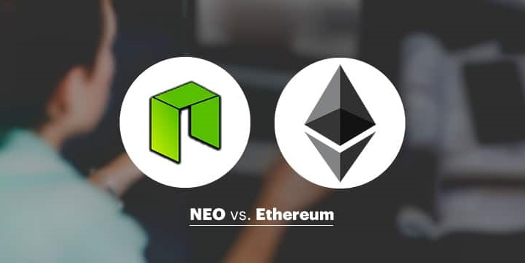
NEO vs. Ethereum
A Quick Comparison

Slide 19

How Are NEO & Ethereum Similar?
NEO and Ethereum are both blockchain projects specifically designed to host smart contracts, ICOs, and DApps
Their respective blockchains are fueled by crypto-assets (GAS in NEO, Ether in Ethereum)
Both the projects are open-source, Turing complete, and have ample community backing with great and responsive teams

Slide 20
NEO vs. Ethereum
Ethereum is completely implemented and stable
Runs in production for years, heavily used every day
Rich documentation, books, tutorials, courses, etc.
NEO is a "promise to build something"
It is still unusable, e.g. the tools are very primitive
Bad documentation, not working, unfinished
Very far from production quality

Slide 21
How Are NEO & Ethereum Different?
1st Difference – Backers
NEO is:
Backed by the Chinese government
Also backed by WINGS, Alibaba and others, known as China’s Ethereum
Ethereum is:
Not backed by any nation’s government
Supported by the EEA-Enterprise Ethereum Alliance
Volumes about its popularity and potential success on the world’s stage

Slide 22
How Are NEO & Ethereum Different?
2nd Difference – Consensus Mechanism
NEO:
Uses a delegated Byzantine Fault Tolerance (aka dBFT) consensus mechanism, which is an improved form of proof-of-stake
Ethereum:
Ethereum uses a proof-of-work mechanism
dBFT is believed to be more energy efficient than proof-of-work

Slide 23
How Are NEO & Ethereum Different?
3rd Difference – Divisibility
NEO:
The native crypto-fuel of NEO only exists in whole numbers: 1, 5, 100, 200…
Ethereum:
The native crypto-fuel of Ethereum is divisible, e.g. 0.0003 ETH
4th Difference – Fueling the Blockchain
NEO produces a special crypto asset called Neo GAS used as a fuel
In Ethereum, small units of Ether are used as “gas” to fuel the network

Slide 24
How Are NEO & Ethereum Different?
5th Difference – Smart Contract Languages
NEO’s smart contracts and DApps can be written in C# and Java
Ethereum – uses a specialized language called Solidity
6th Difference – Long Term Goals
NEO is focused on making a smart economy by running smart contracts and DApps
Ethereum is going in the direction of becoming the world’s only supercomputer based on the blockchain
By hosting numerous use cases of digital identity, computing and decentralized exchanges

Slide 25
How Are NEO & Ethereum Different?
7th Difference – Throughput
At present, NEO can handle 10,000 transactions per second
Ethereum can handle 15 transactions per second
This is currently NEO’s biggest advantage
8th Difference – Quantum Safe
NEO is promised to be be quantum computer-proof (still not implemented)
Ethereum, and every other cryptocurrency, is not quantum computer-proof

Slide 26
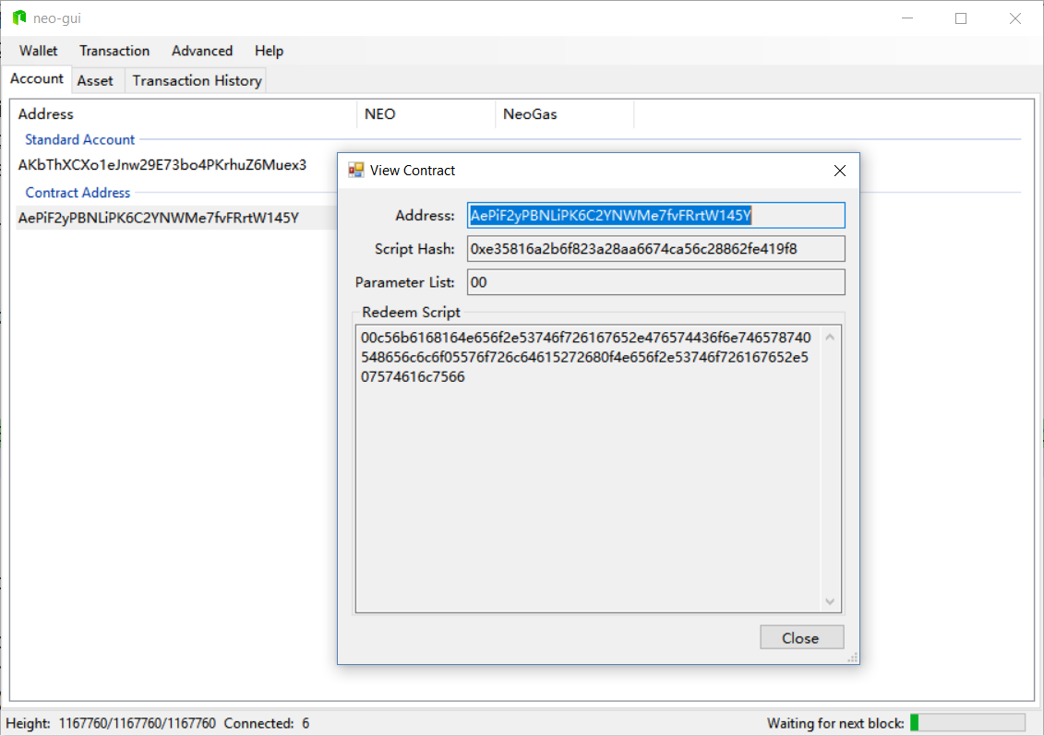
Exercise
Install NEO GUI and Deploy a Contract

Slide 27




Summary
NEO Background (Antshares)
Coins: NEO and GAS
How to get and store GAS ?
What is GAS purpose ?
NEO Smart Contracts
Advanced features powered by GAS
Comparison between NEO and Ethereum

Slide 28
Smart Contracts with NEO
http://www.kingsland.academy

Slide 29
Resources
Antshares Rebrana to NEO https://bitcoinmagazine.com/articles/antshares-rebrands-introduces-neo-and-new-smart-economy1/
NEO Smart Contracts: http://docs.neo.org/en-us/
Neo Smart Economy Concept: https://medium.com/@MalcolmLerider/what-is-neo-smart-economy-381a4c6ee286
NEO and GAS: https://coincentral.com/gas-introduction-neogas-crypto-within-neo/
Advanced Features Powered by GAS: https://hackernoon.com/what-is-neo-and-what-is-gas-5b9828a1aa65
Example of Simple NEO Smart Contract: http://docs.neo.org/en-us/sc/test.html
NEO vs Ethereum: https://hackernoon.com/neo-versus-ethereum-why-neo-might-be-2018s-strongest-cryptocurrency-79956138bea3

